Slide 1
Solar System Studying (SSS)
VR Interlinked solar system Learning Content 『 SSS 』 interim
INC-CAPSTONE DESIGN 1
Porf. Cho Young-ju
Martian
20164260 Jeong So-yeon
20134590 Moon Jong-jin
20134860 Lee Jae-hoon

Slide 2
CONTENTS
01
Project Introduction
02
Stage Description
03
Rehearsal Video
04
Supplementation & Q&A

Slide 3
Project introduction

Slide 4
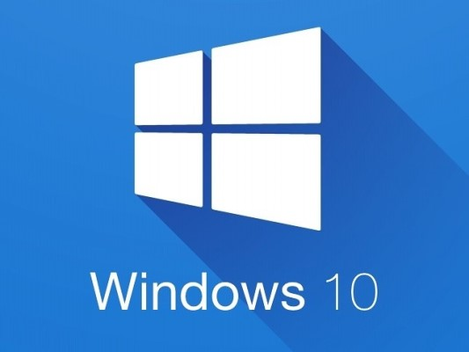
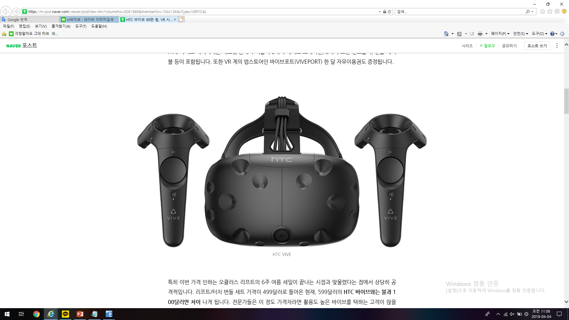


01 Project Introduction
* Project Introduction
Solar System Studying : Solar System Learning Content for Students
* Operating System
* VR device
Windows 10
HTC VIVE
* Implementation tools
Unity 2018.2.5f1 (64-bit)
Blender

Slide 5
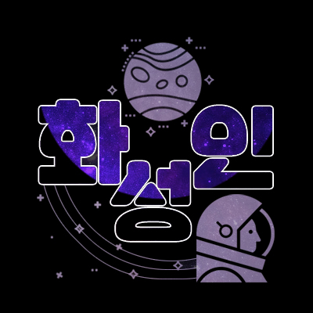
01 Project Introduction
* Development Schedule
 | 1 | 2 | 3 | 4 | 5 | 6 | 7 | 8 | 9 | 10 | 11 | 12 | 13 | 14 | 15
Topic
Map
Function
UI
VR
Supplementation
Jeong So Yeon
- Program Development
Moon Jong Jin
- Program Development
Lee Jae Hoon
- Presentation & Survey

Slide 6
Stage description

Slide 7
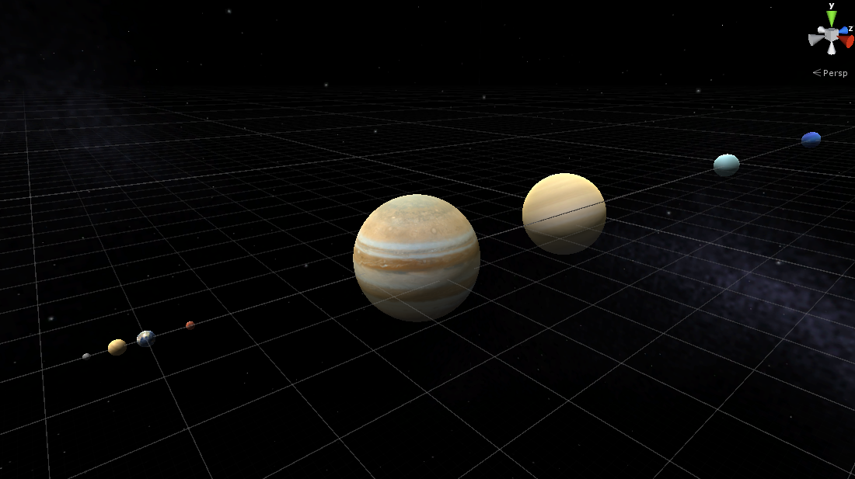
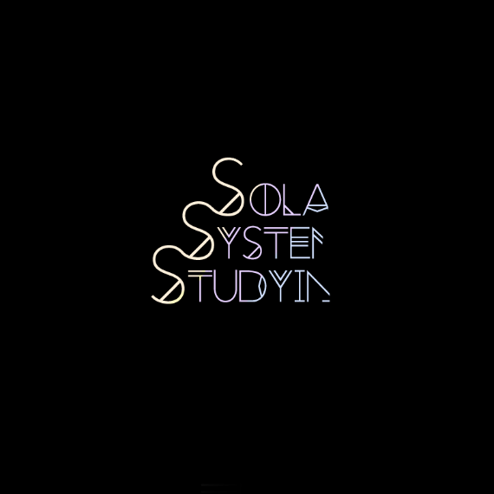
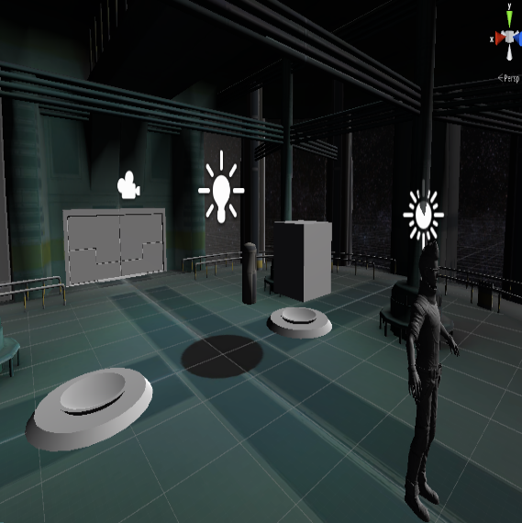
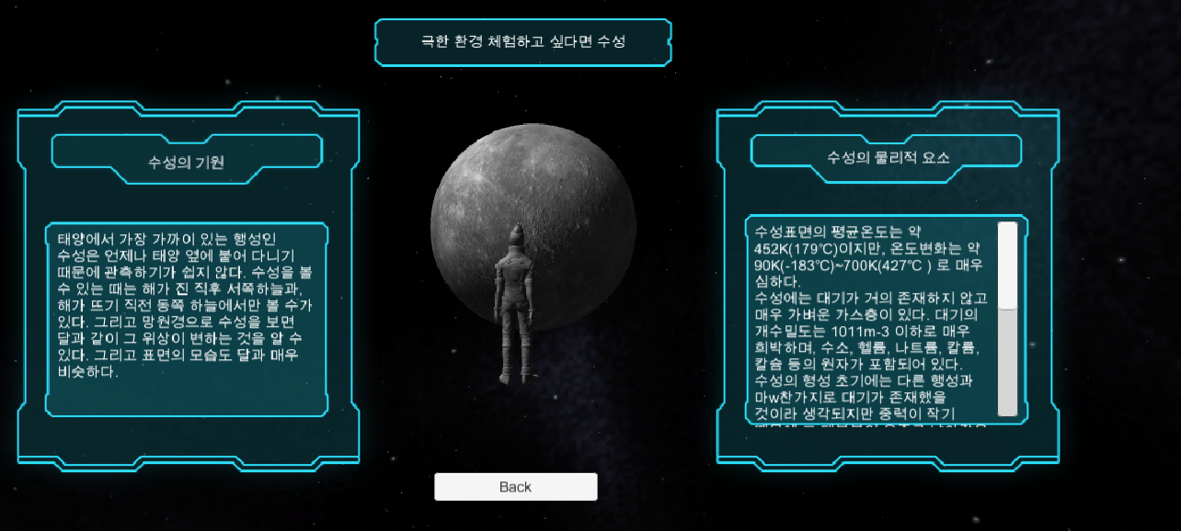
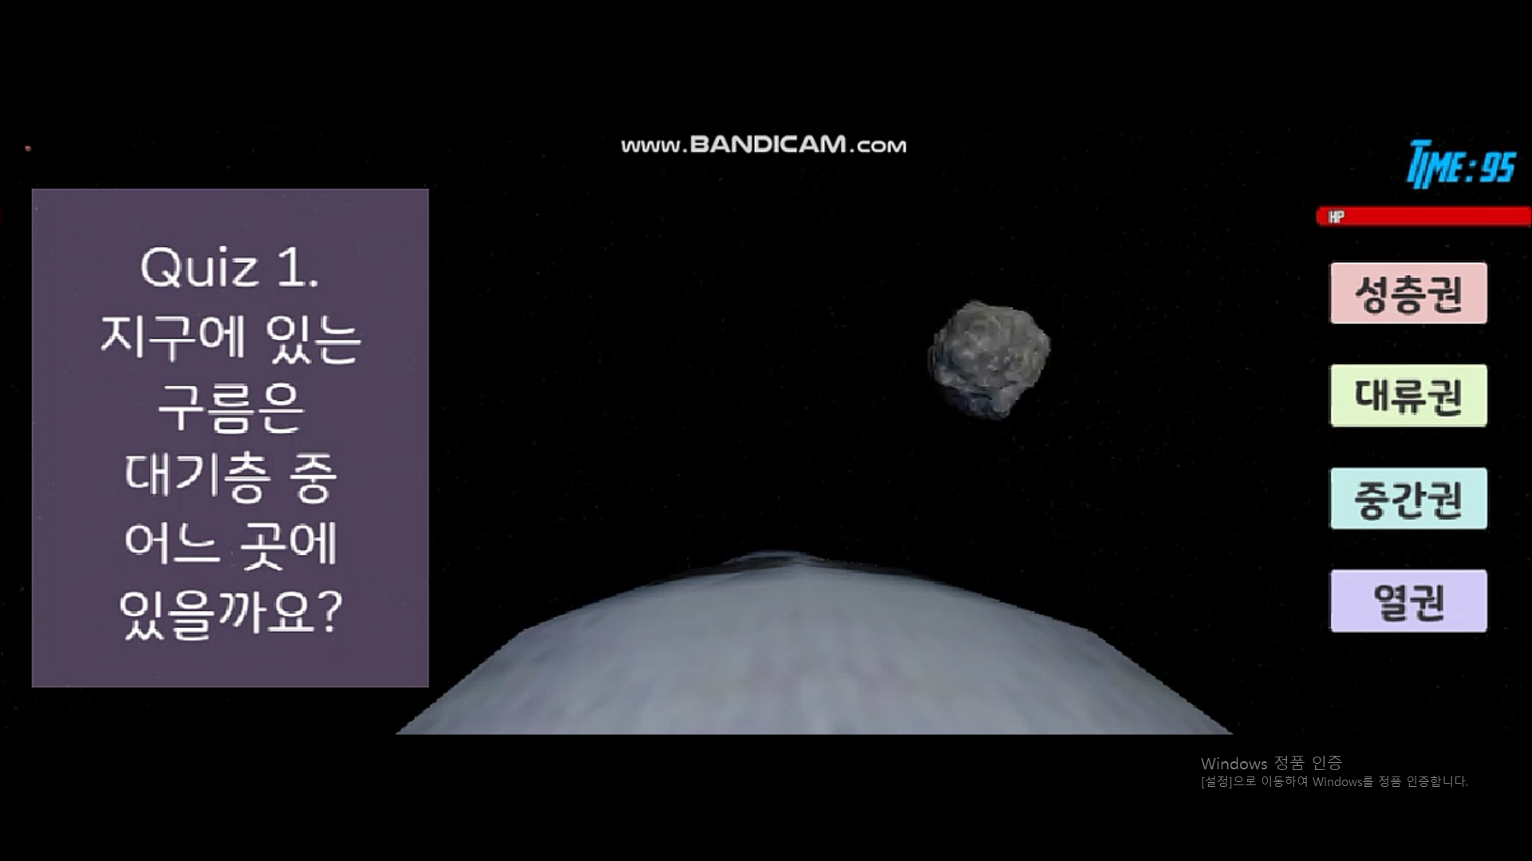
02 Stage Description
Solar System Learning Content for Students
Solar Planet
Divide into inner planets and outer planets to observe the dynamic motion of each planet
Main
Stage
Opening
Learning
To travel between the sun and the planets of the solar system, to study through visual and auditory explanations
Reviewing
Earth must be protected from flying meteors. Recall what you have learned through learning through games

Slide 8
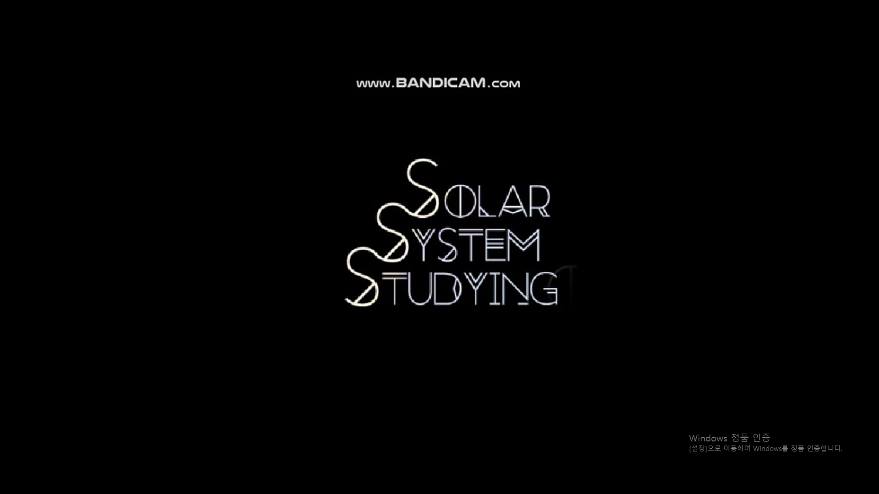

02 Stage Description
Opening
Main Stage
After the team name “Martian"
logo appeared, Content name "Solar System Studying" appears
1. Solar System Planetary
Movement Observation
2. Learning
3. Reviewing(Quiz)

Slide 9
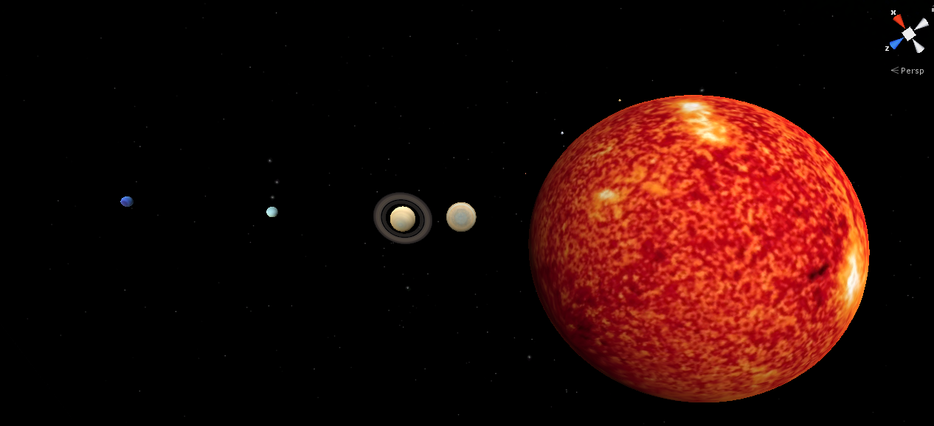
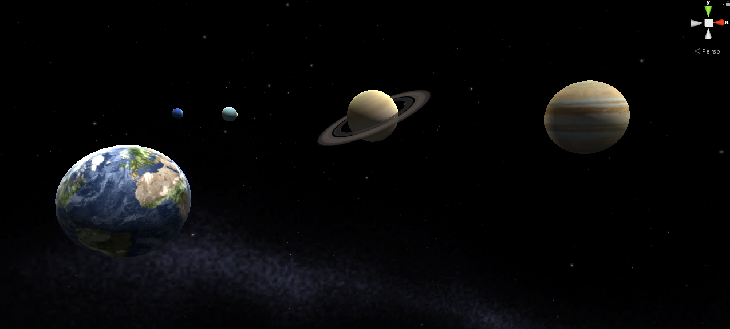
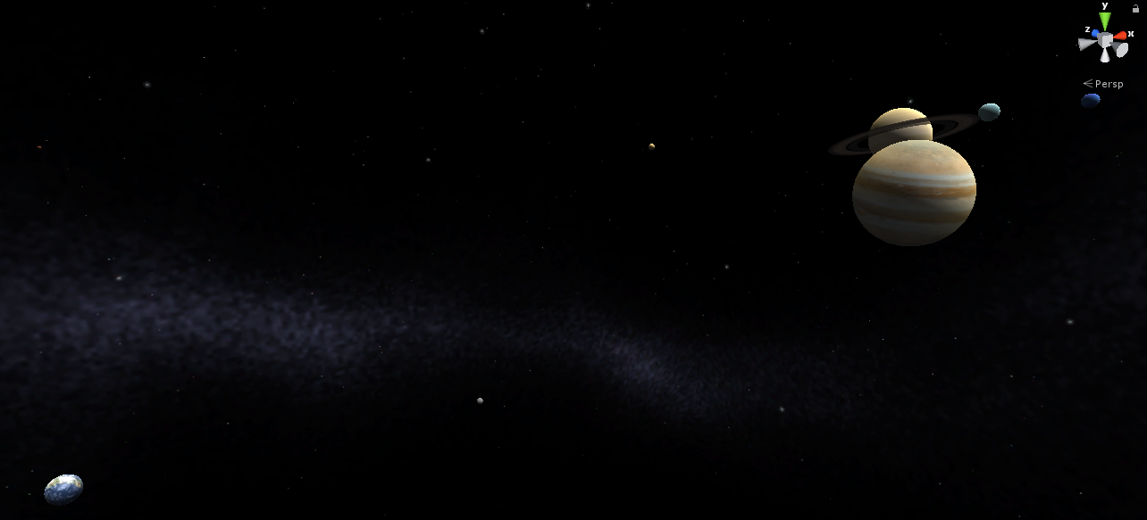
02 Stage Description
1) Movement of solar planets
Observation of the motion of the planets belonging to the sun and the solar system. an observation of the outer appearance of the planets in the sun and the solar system You can check the orbit and rotation of planets that revolve around the sun.

Slide 10
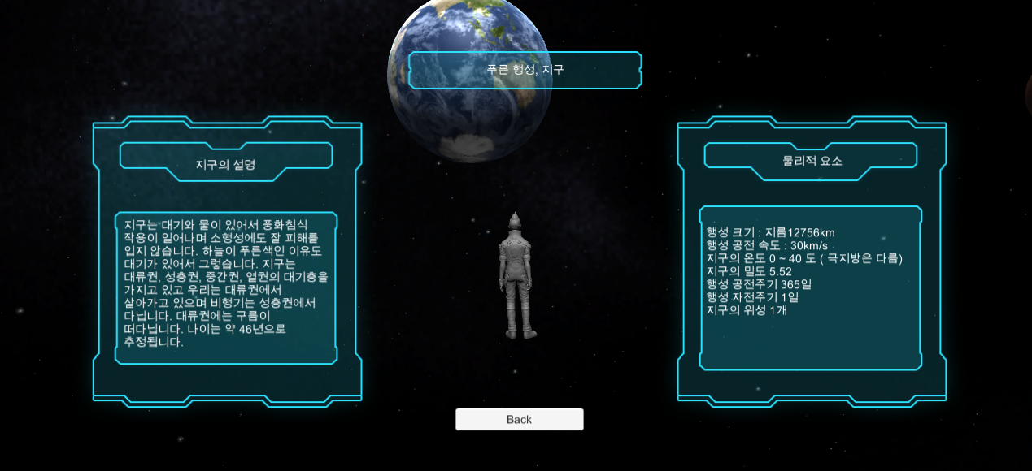
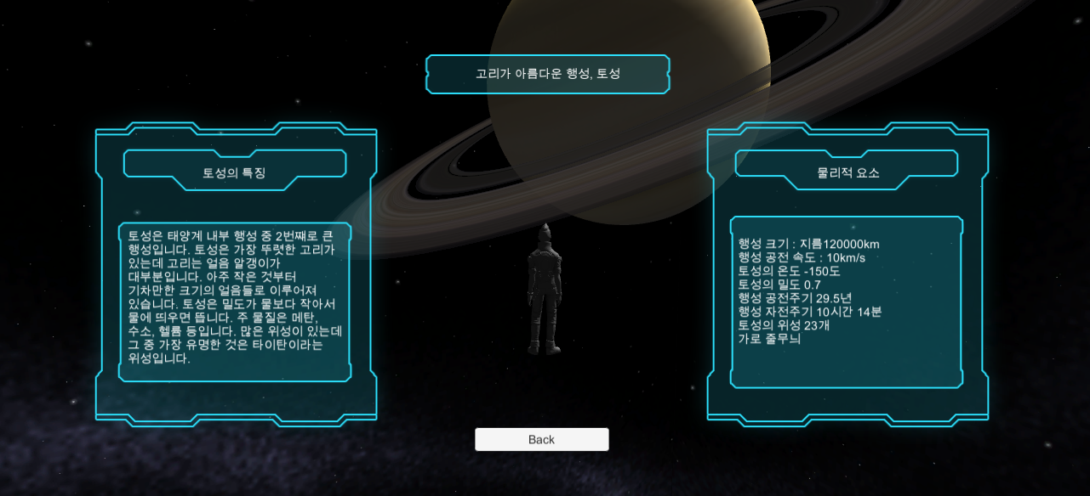
02 Stage Description
2) Learning Solar System
As soon as you approach each planet or sun, you can learn your voice and the corresponding stars. Additional information, including physical elements for the sun or planet. After learning, quiz games are played.

Slide 11
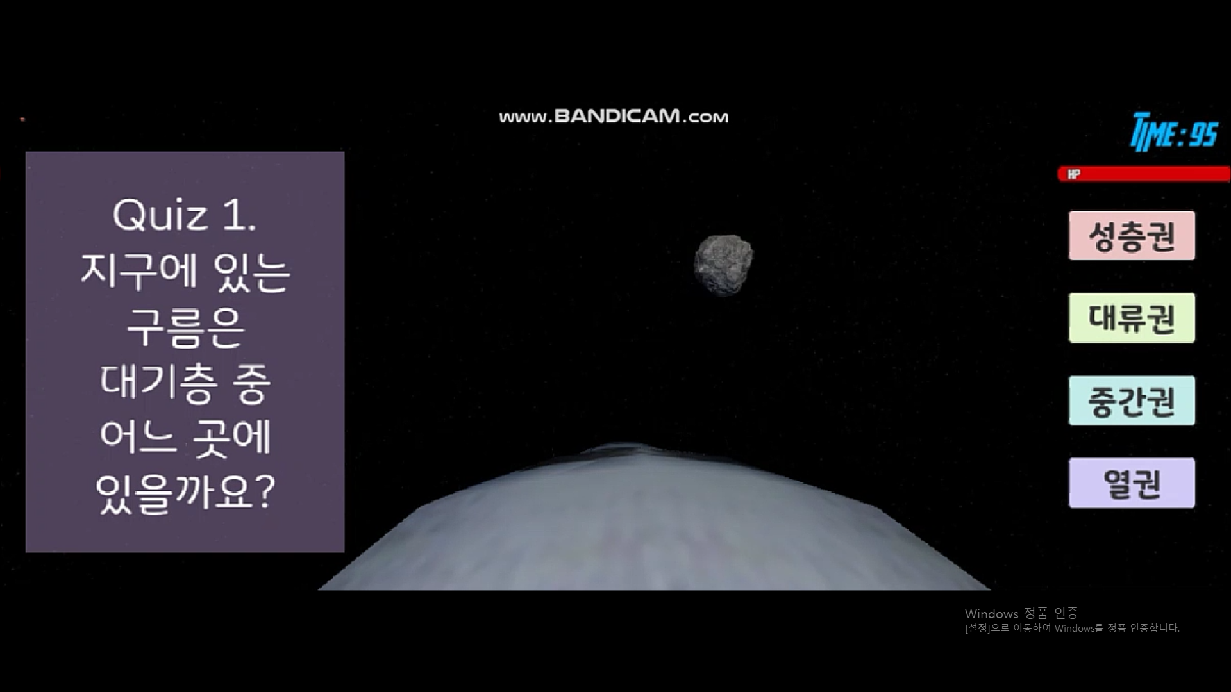
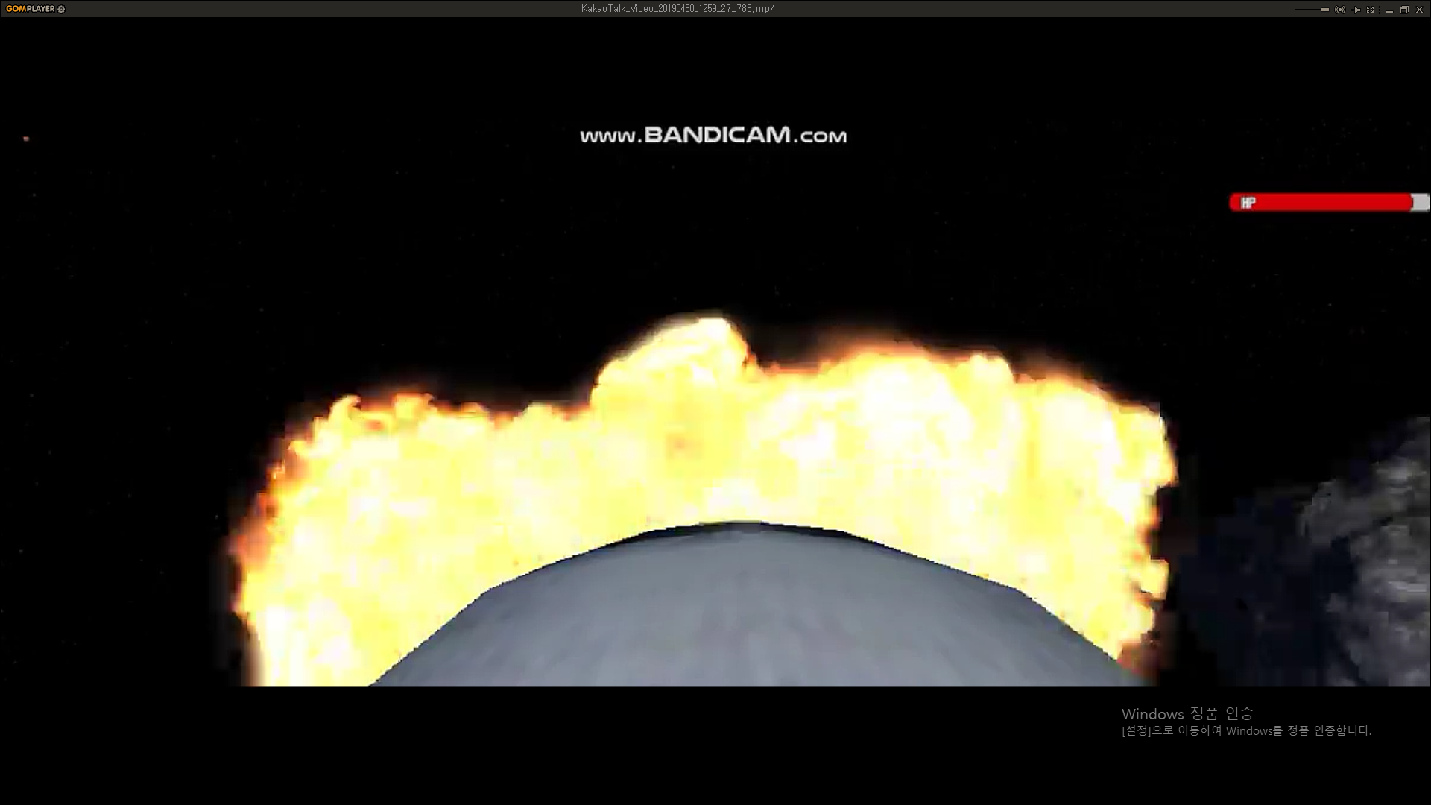
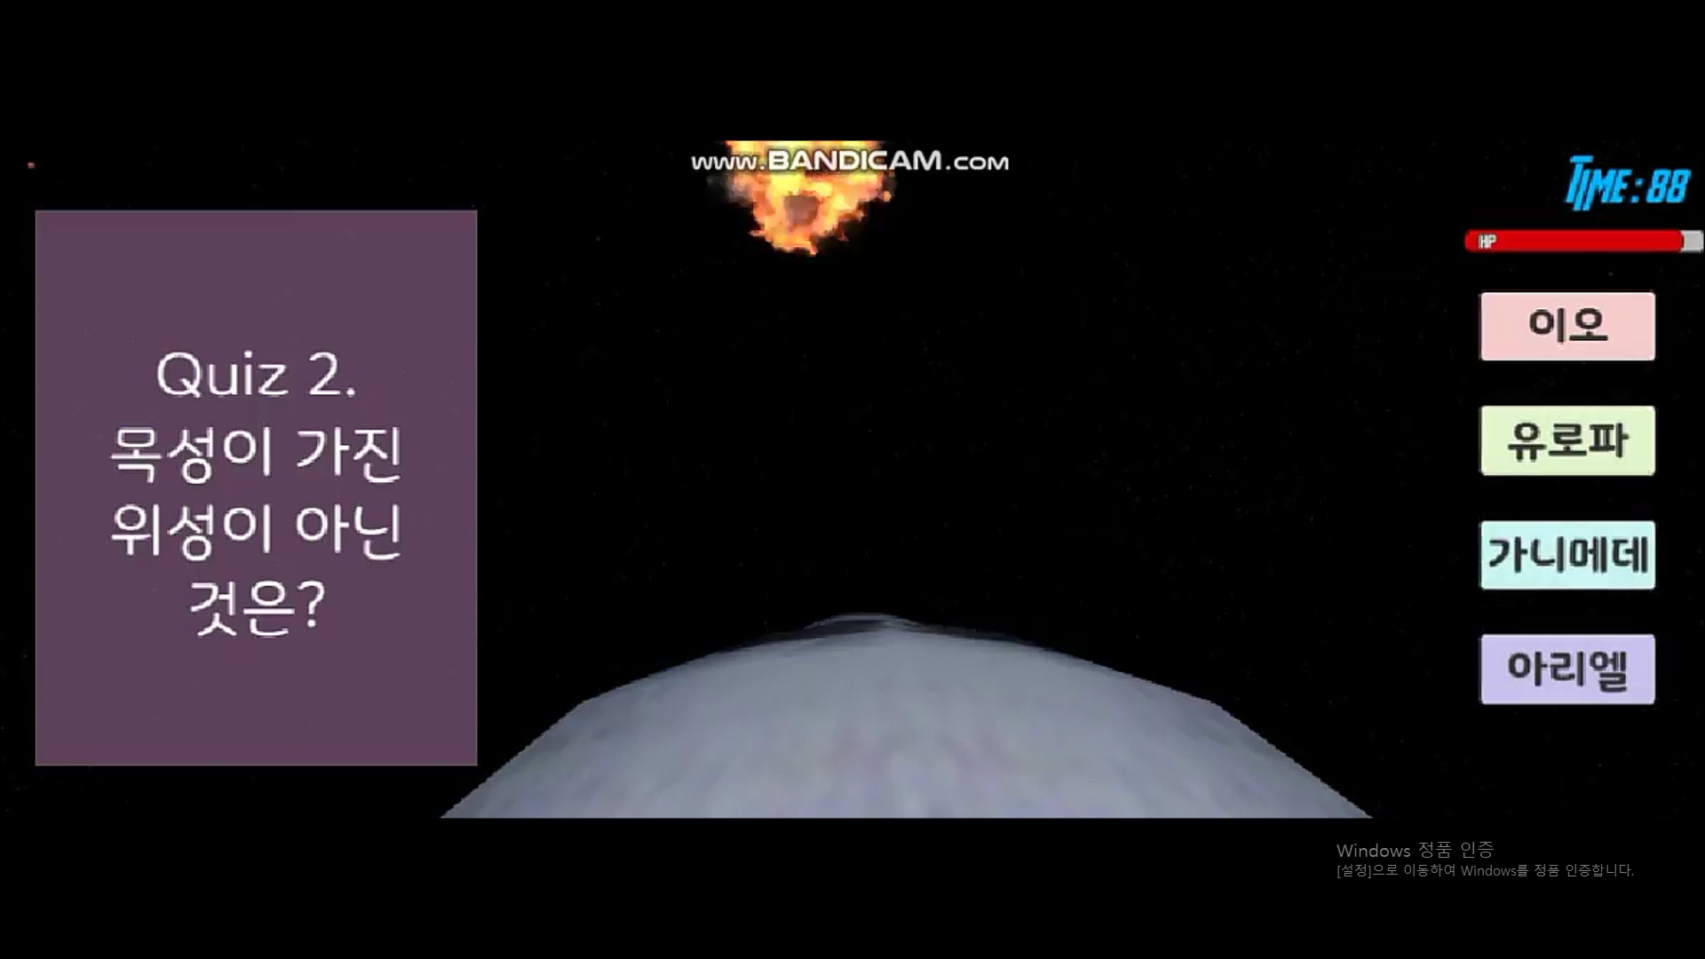
02 Stage Description
3) Reviewing Solar System
The last game to review after learning about the solar system. Quiz and selection are given, and if you answer the quiz while the meteor is flying and the meteor is coming, the meteor will blow up, or the airship will be attacked.

Slide 12
Rehearsal video

Slide 13
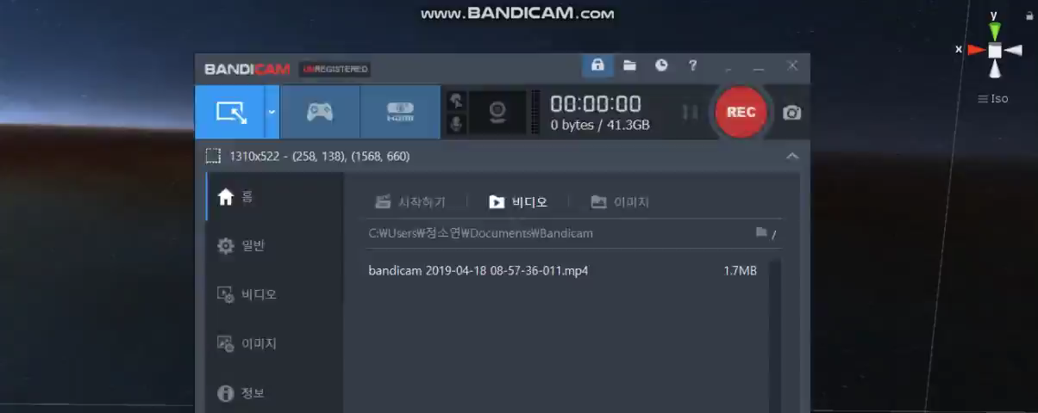
03 Rehearsal Video
Opening

Slide 14
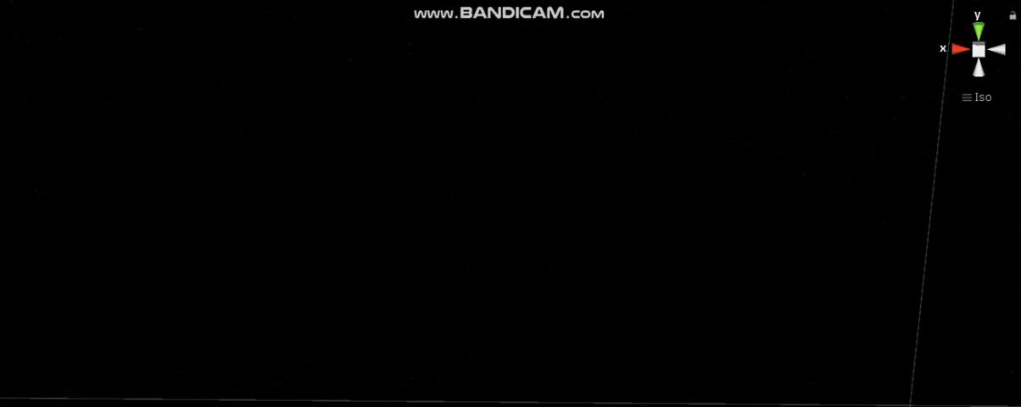
03 Rehearsal Video
Quiz Game

Slide 15
Supplementation
& Q&A

Slide 16
04 Supplementation & Q&A
Adding sound On the solar system learning stage, Record the description sound for each planet. To be added to the text description.
2) Modifying objects Three objects on the main stage
will be changed to match the
characteristics of each stage.
3) VR interworking VR link after stage and object
implementation is complete.
Modify UI and related functions.
4) Other supplementary items Modification of unnatural
phenomena resulting from
moving scenes to VR.
VR
?

Slide 17
Q&A

Slide 18
The
End

